Slide 1

Credit Risk Assessment Pipeline: Credit Data Processing & Risk Analytics using Azure & Databricks
B.Kumara Swamy
Astha Kesharwani
D.Vaishnavi
K.Rajkumar
P.Bhanu Bharath
B.Naga Pavan Kumar

Slide 2
Project Overview & Objectives
Built a cloud-based ELT pipeline to process credit risk data from multiple sources.
Implemented Medallion Architecture using ADLS Gen2 and Databricks — Bronze → Silver → Gold.
Used Azure Data Factory and PySpark/DBT for data ingestion, cleansing, and transformation.
Integrated applicant, credit history, loan, and economic datasets into a unified data platform.
Prepared analytics-ready credit risk data to support loan assessment, reporting, and dashboards.

Slide 3
Problem Statement
Managing large volumes of credit and loan data from multiple source datasets.
Handling missing, duplicate, and inconsistent data to maintain reliable credit information.
Integrating applicant, credit history, loan, and economic data into one unified pipeline.
Identifying high-risk applicants efficiently using accurate and standardized credit data.
Providing trusted risk insights and reports to support faster and better loan approval decisions.

Slide 4
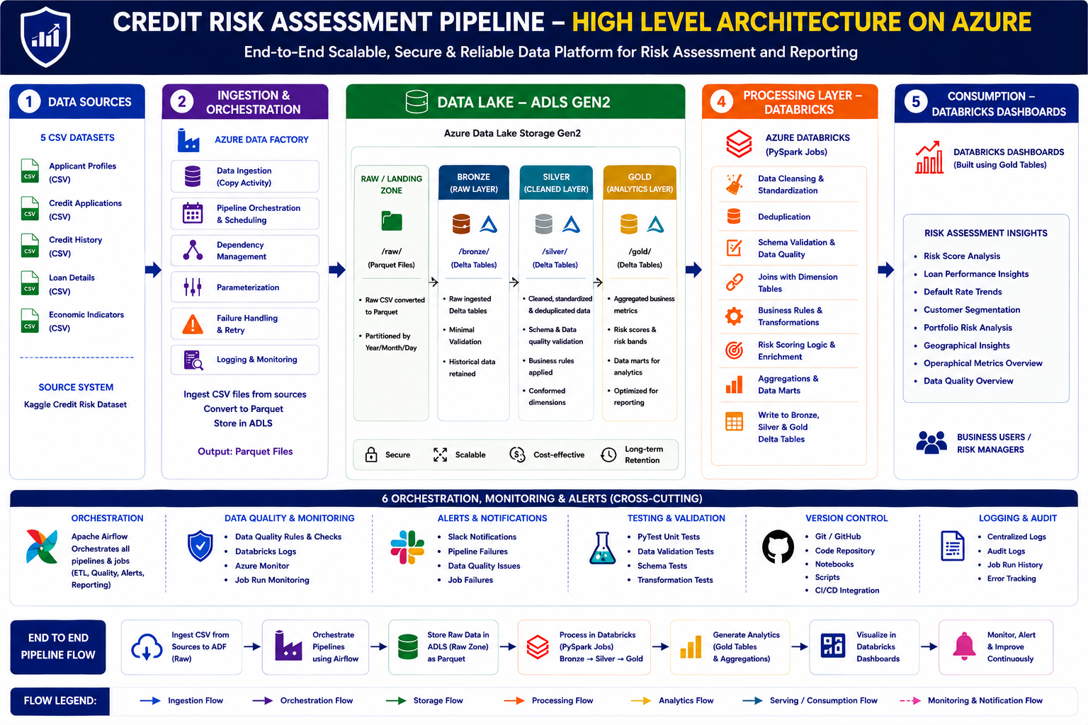
Lakehouse Architecture (High - Level Design)

Slide 5
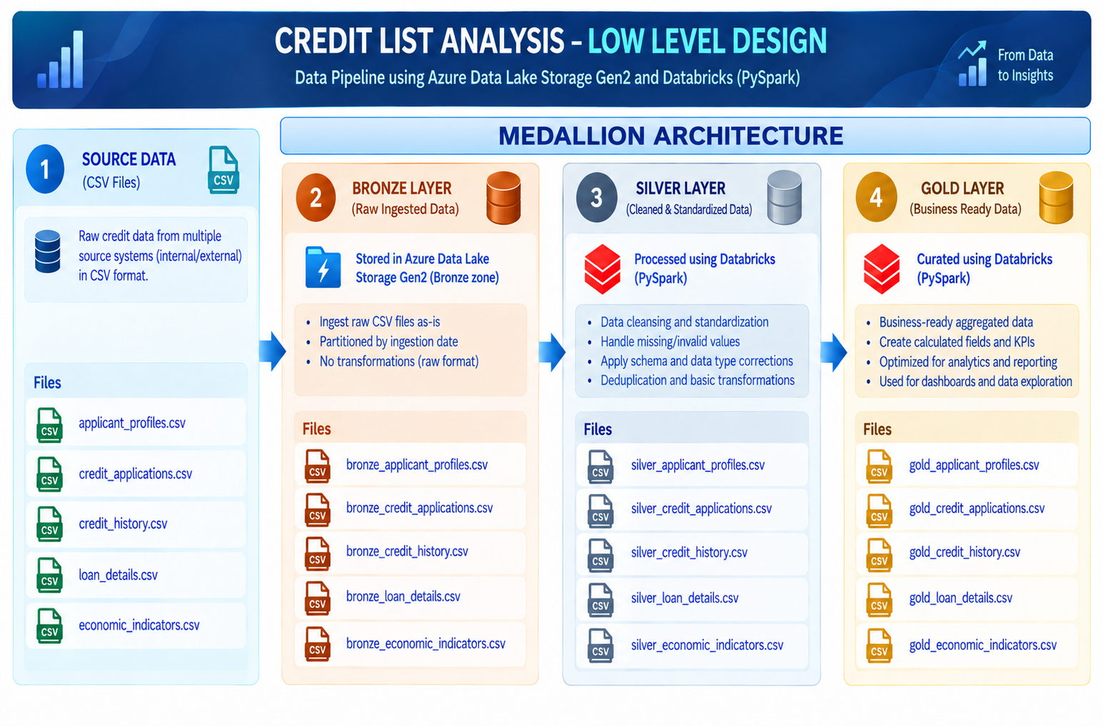
Low-Level Design

Slide 6
Bronze Layer — Raw Data Preservation
Bronze Layer – Target Tables, Implementation & Key Principles
Source Dataset | Bronze Target Table | Implementation | Key Principle
applicant_profiles.csv | credit_catalog.raw.applicant_profiles | Ingest applicant details from ADLS Gen2 and store them as a raw Delta table. | Source Preservation
credit_application.csv | credit_catalog.raw.credit_application | Load loan application records with minimal transformation and basic schema validation. | Raw Data Integrity
credit_history.csv | credit_catalog.raw.credit_history | Ingest historical credit records and retain the original source structure. | Traceability
loan_details.csv | credit_catalog.raw.loan_details | Store loan amount, tenure, interest rate, and related details in Delta format. | Data Reliability
economic_indicators.csv | credit_catalog.raw.economic_indicators | Ingest economic indicator data for downstream credit risk enrichment. | Historical Retention

Slide 7
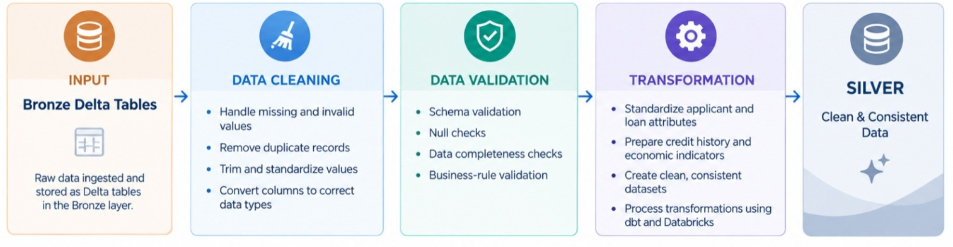
Silver Layer — Cleansing & Transformation
OUTPUT : credit_analysis_catalog.silver.Silver_applicant_profiles

Slide 8
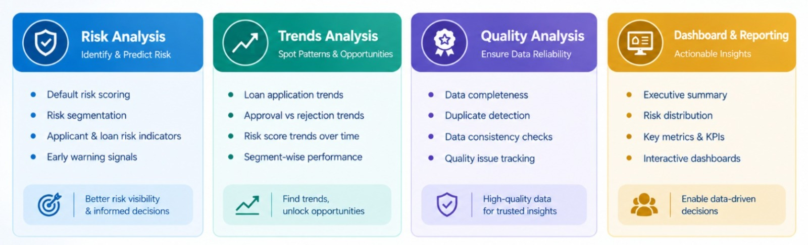
Gold Layer(Retail Analytics)
Target : credit_analysis_catalog.gold.dim_applicant

Slide 9
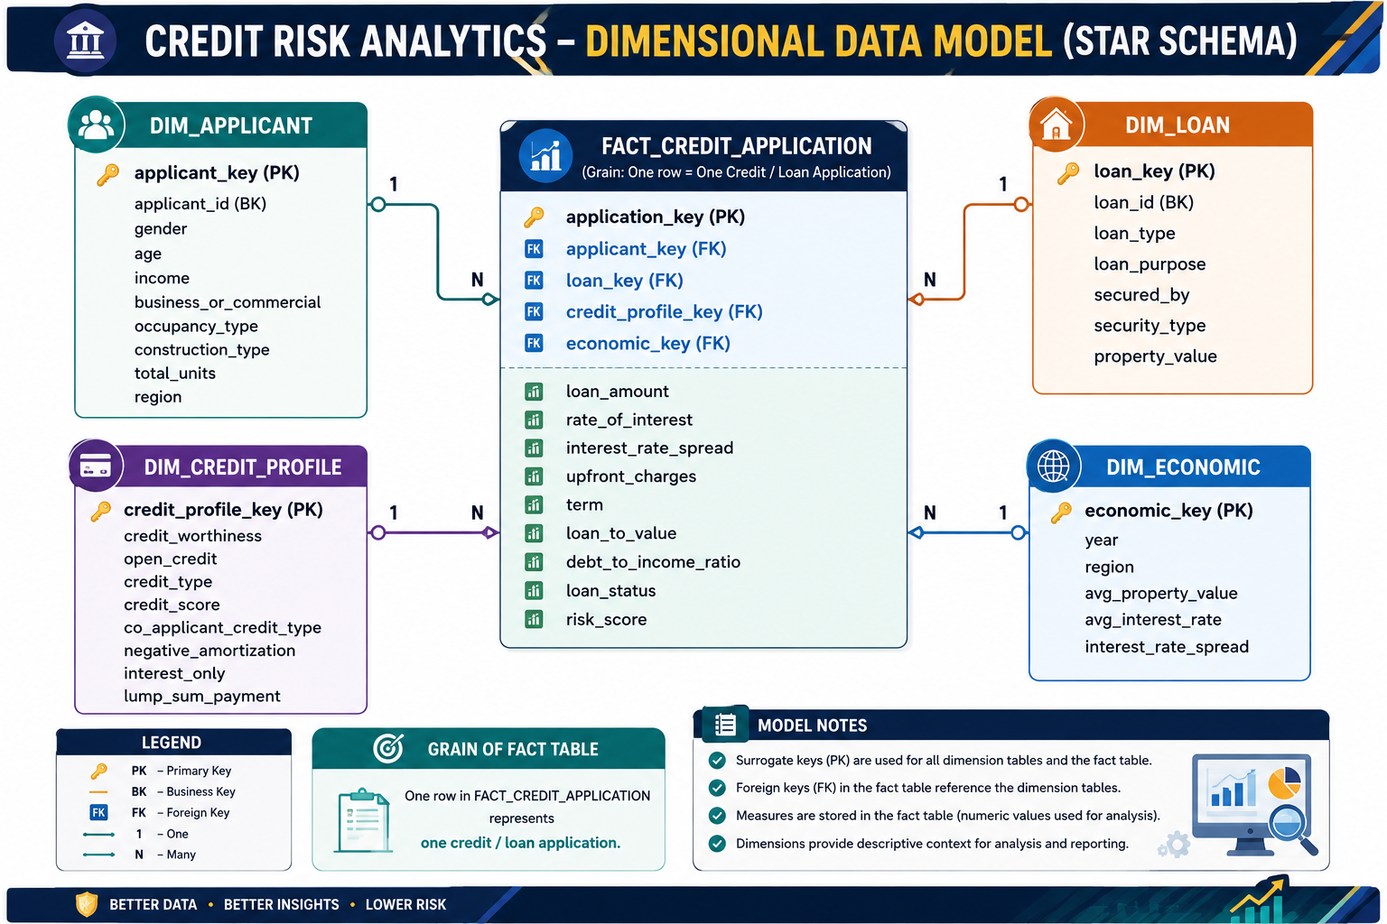
Credit Risk Analytics(Star Schema)

Slide 10
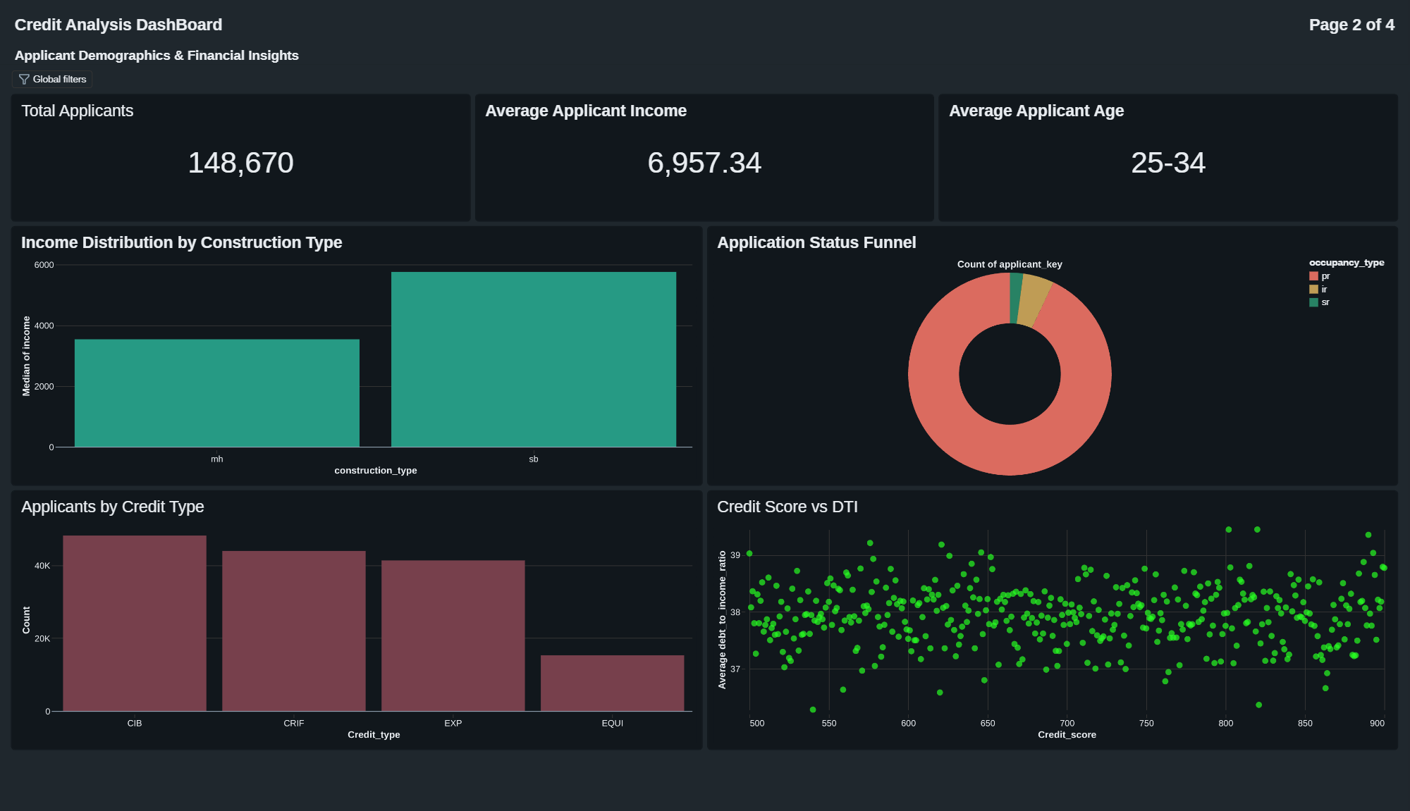
DashBoards

Slide 11
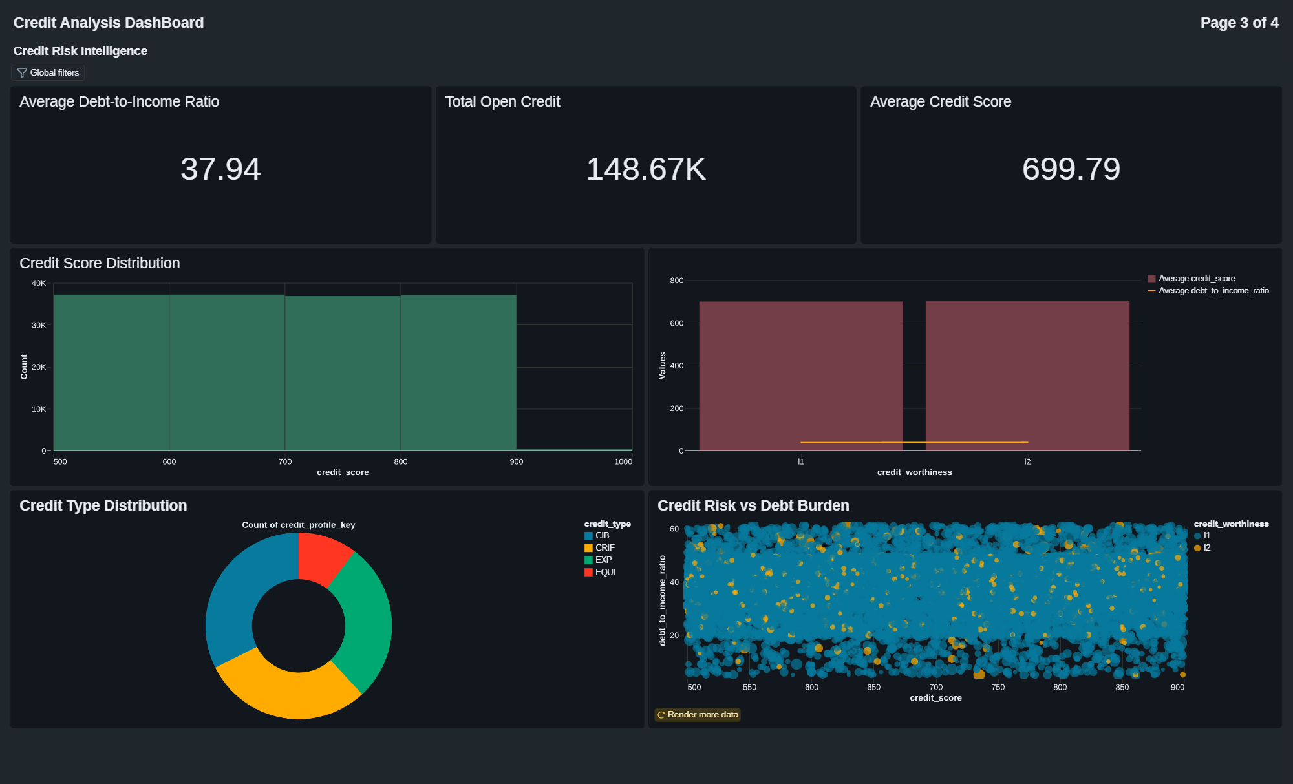
Credit Risk & Intelligence

Slide 12
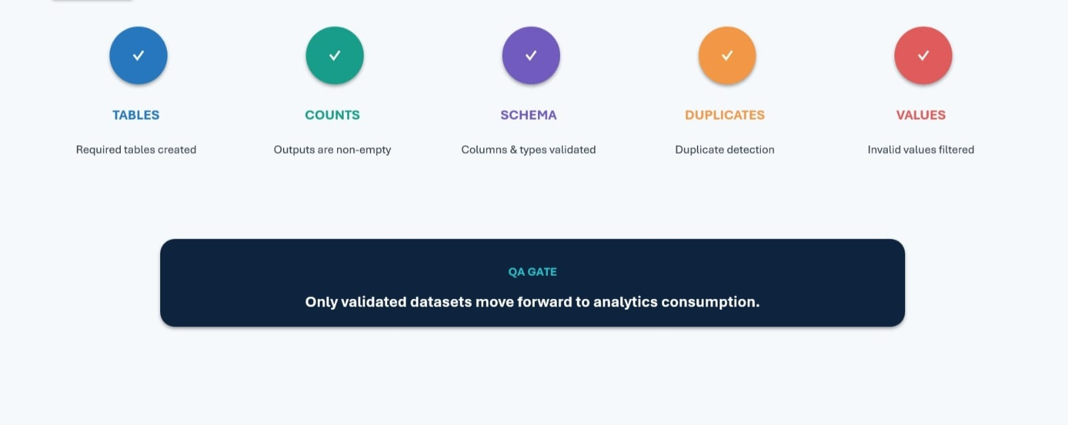
PyTest & Data Validation

Slide 13
Data Quality & Error Handling
Performed schema validation to ensure correct data types and table structure.
Applied null checks and data completeness validation across credit datasets.
Implemented duplicate detection and removal for applicant and loan records.
Applied data standardization for inconsistent values, formats, and categories.
Implemented error logging and pipeline monitoring for failed Databricks/DBT tasks.
Validated Silver and Gold outputs to ensure accurate and reliable credit risk data.

Slide 14
Alerts & Monitoring (Slack Integration)
Created a Slack channel for Credit Risk Pipeline
Configured Slack webhook integration for pipeline notifications.
Enabled Databricks Job success and failure alerts.
Sent real-time notifications for pipeline execution status.
Monitored Bronze → Silver → Gold job and task status.
Configured retry and failure notifications for failed tasks.
Tracked execution logs and alerts for faster troubleshooting.

Slide 15
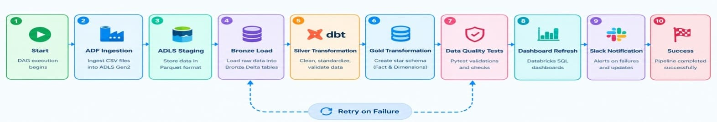
Airflow Pipeline Automation
Orchestration Responsibilities
Schedules the daily execution of the pipeline.
Manages task dependencies (e.g. Bronze → Silver → Gold).
Triggers Databricks jobs and DBT models in the correct order.
Monitors task status and handles failures with retries.
Sends notifications to Slack when any task fails or completes.
Provides logs and visibility for troubleshooting

Slide 16
Business Insights & Outcomes
Enabled accurate credit risk assessment using applicant, loan, credit history, and economic data.
Categorized applicants into High, Medium, and Low risk using derived risk scoring logic.
Improved data-driven loan decisions through centralized and standardized credit data.
Reduced data inconsistencies and duplicate records through automated ETL and data-quality checks.
Delivered actionable credit risk insights through Gold-layer metrics and Databricks dashboards.
Improved pipeline scalability and performance using ADLS Gen2, Delta Lake, and Databricks.
Enhanced pipeline reliability with automated monitoring, Slack alerts, and Pytest validation.

